Slide 1
PyGame Chess
Edward Enriquez CS2520 Project

Slide 2
Problem Statement
Key Features
The goals of the Python project are as follows:
Use PyGame and NumPy libraries to build an interface to play 2 player local chess.
Incorporate all standard chess rules and conventions
Basic moves
Castles
En Passant
Pawn Promotion
Resignations
Call for Draws
Timed Play
Contains 3 mode of timed play (non timed/easy , blitz and bullet)
Records stats of both players in the current session
Python Features:
Object Oriented Programming for creation of multiple classes
List Comprehensions for filtering objects with specific property traits
Imported Libraries:
PyGame - cross-platform set of Python modules designed for creating 2D games. Allows for event handling, collision detection, manipulation of in game objects.
NumPy - package for numerical computations in Python which allows for multidimensional arrays. Used in this project for ease of indexing and finding objects whose particular properties were known (numpy.where())

Slide 3
THE CODE

Slide 4
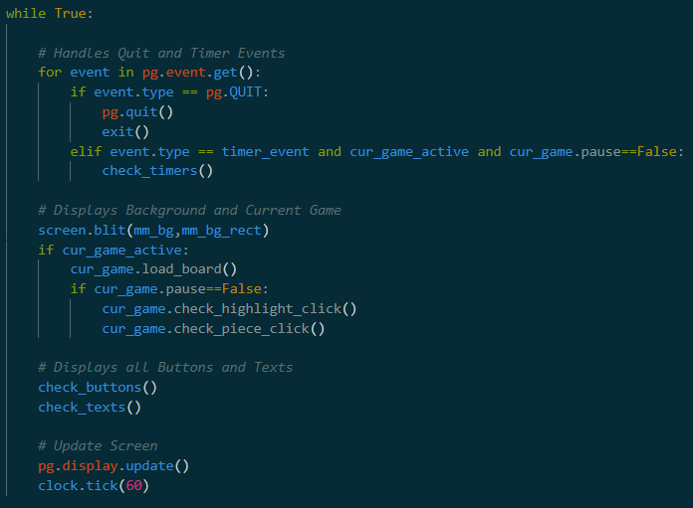
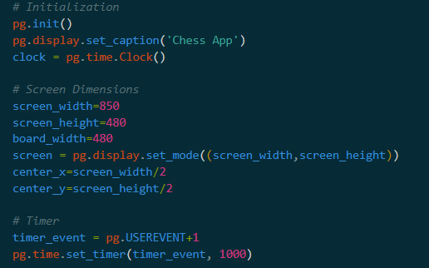
PyGame Initialization
The right image is the main PyGame loop which updates and displays the current frame on the screen. There is also a for loop in this main loop for catching quit and timer events .
PyGame requires a screen and clock object to initialize. A timer event object was also created
Display/screen contains a blit() method. This method requires a Surface (object to display) and a Rectangle (positional object to display at) .

Slide 5
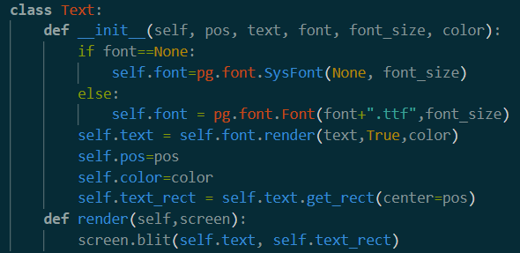

Text Class
The Text Class helps renders a specified text, with font, font size, color, and position.
Text contains render() method which does the actual displaying.
The check_texts() function loops through all current visible Text objects and displays them. This check_texts() function is seen called in the main PyGame loop.

Slide 6
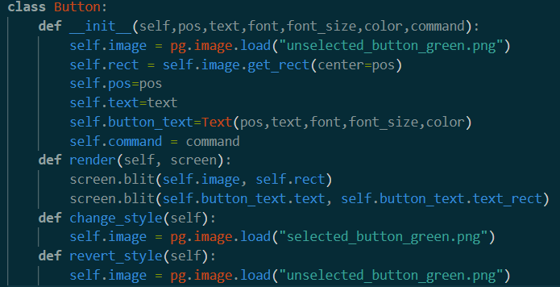
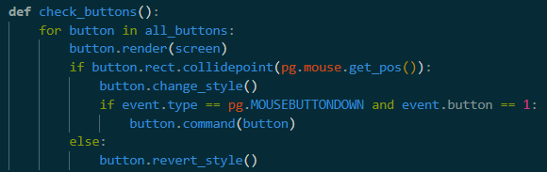


Button Class
The Button Class helps renders buttons.
Each button has an image, position , Text object and a command.
Also has own render() method used in check_buttons() function to display all current buttons. The button image and text are displayed simultaneously.
Button also has change_style() and revert_style() methods which are used to change between the selected and non-selected images of the buttons

Slide 7
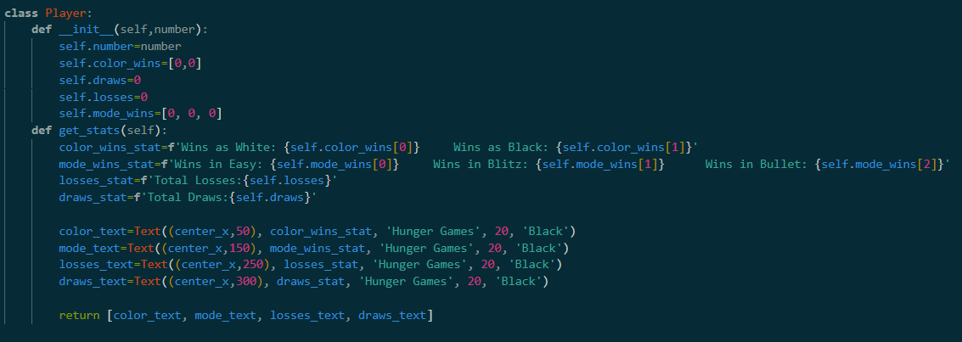
Player Class
The Player class stores: player number (Player 1/ Player 2) , number of wins with a certain color , number of wins in a certain mode , number of draws and number of losses.
Player also has a get_stats() method which creates a list of Text objects containing all of the Player stats. This list is assigned to list of visible texts when needed.

Slide 8
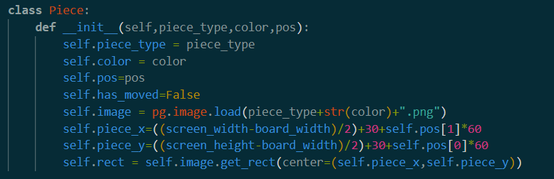
Piece Class
The Piece class holds all the information relevant to a particular piece.
Piece types denoted by characters: ‘p’, ‘r’, ‘b’, ‘n’, ‘q’, and ‘k’. (‘n’ is knight to avoid conflict with king)
The color property is an integer, 0 for white and 1 for black. This is helpful for indexing list/arrays
The position of the piece is a tuple in the form (row,column). These values are turned into pixel positions for display
The has_moved property is used for chess moves that are only viable if the piece has not moved. (Castles and pawn double jumps)

Slide 9
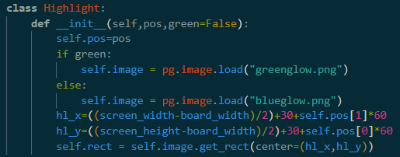
Highlight Class
The Highlight class displays lit up positions on the board.
The position of the Highlight is given as a (row,column) tuple
Default for a Highlight is blue which is used to display legal moves. When the Highlight is green, this is used to indicate that the king is in check

Slide 10
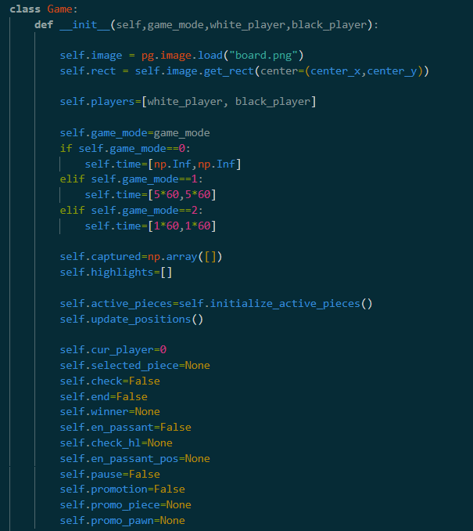
Game Class (__init__)
The Game class contains game properties like game mode, time left, player color assignment
Also contains current state of the chess game such as pieces captured, selected piece, current player, check etc.
An important property is the active_pieces property, a numPy array of Piece objects, that are in play. Another is the all_positions property which is a list of all current positions of the pieces in play. This list is updated along with the king’s positions in the update_position() method
Similar to the Piece class, cur_player is an integer for indexing and for ease of changing between black and white with the expression, cur_player=1-cur_player

Slide 11
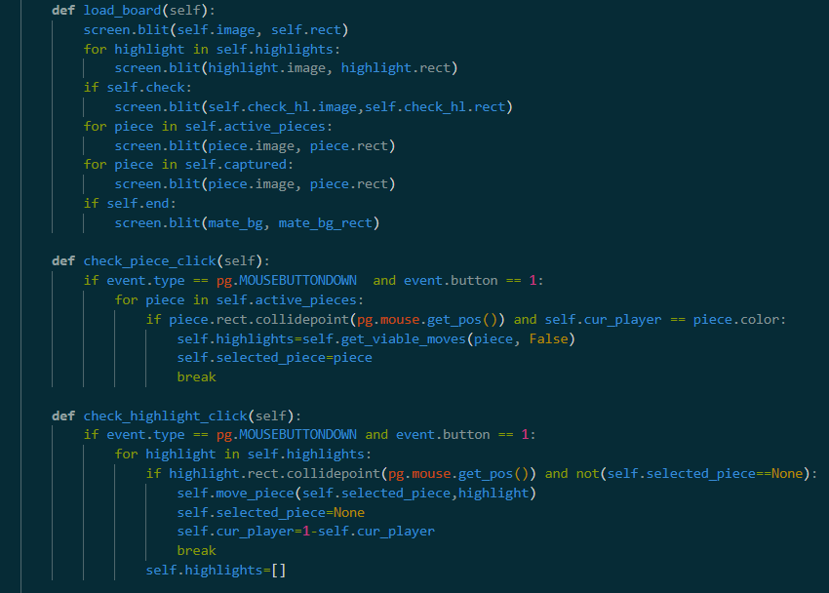
Board Dynamics
These are the three Game methods controlling board dynamics that run in the main PyGame loop
load_board() - draws board, all current highlights, all active pieces, all captured pieces, and if the game ends, a background.
check_piece_click() - checks if a piece is clicked and sets the game’s highlights property to a list of all viable moves that piece can make via the get_viable_moves() method
check_highlight_click() - checks if a highlighted square is clicked and moves the selected piece to that square.

Slide 12
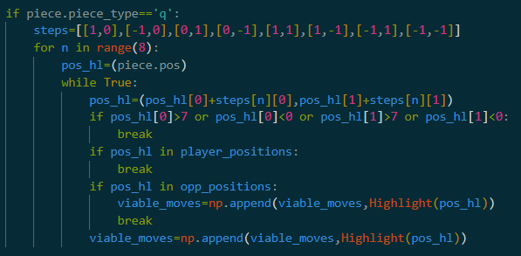
Chess Rules
The rules of chess are mainly implemented in the get_viable_moves() method of the Game class.
This method has a Piece object as its input parameter
Each piece type has a list of “steps”. For each step, the piece position is repeatedly moved in that direction until it hits a piece or the edge of the board. All positions along the way are appended to viable moves list as Highlights
In the case of the king and the knight, only 1 iteration per step.
Pawns have a more unique coding and kings have additional coding for castles

Slide 13
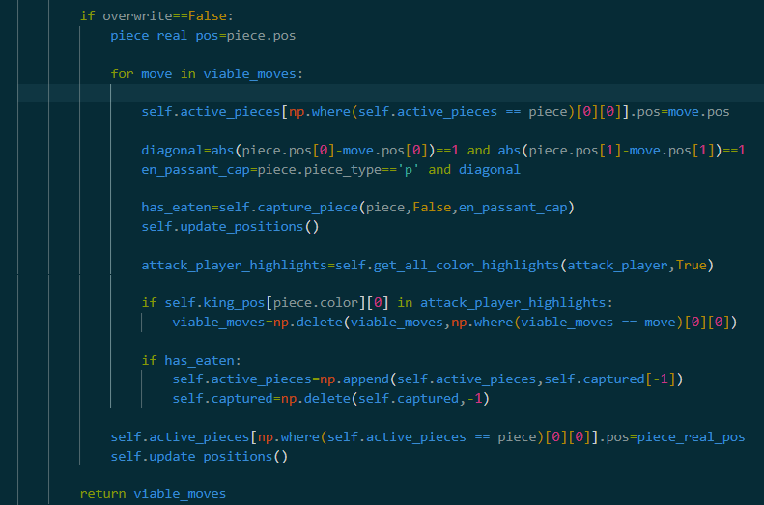
Chess Rules (Continued)
It is crucial to remove any moves that puts the current player’s king in check. These moves are not allowed
For each of the piece’s viable moves, the piece is artificially moved to that position and then the opposite player’s viable moves are check to see if initial player’s king is in check
If it is, then the move is removed from the list of viable moves. The piece is moved backed after every iteration.
It is not necessary to check if the opposite player’s move would put themselves in check so the variable “overwrite” is used to prevent infinite looping

Slide 14
Other functions
move_piece() - moves selected piece to selected Highlight. Updates piece position, calls capture_piece() method, checks for check and checkmates, contains hardcoding for special move (castle, promotions, en passant)
capture_piece() - checks and handles if a piece moves to square occupied by a different colored piece. Has special hardcoding for en passant, (only move where captured piece is not on captured square).
get_all_color_highlights() - returns a list of all possible moves for all pieces of a chosen color. Helpful for finding checks, checkmates, and ruling out viable moves. Repeatedly calls get_viable_moves().
check_timers() - updates and handles timer based features. This function is called only every second in the main PyGame loop with help of the PyGame handler
button_func() - the function which all buttons are set to call when pressed. In this function there is a large if/elif block which finds the pressed button’s function by identifying its text.

Slide 15
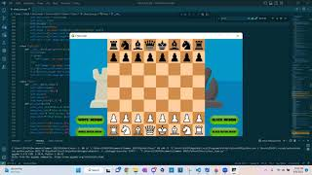
Demo
https://youtu.be/AbkqIUZvPuc

